Slide 1
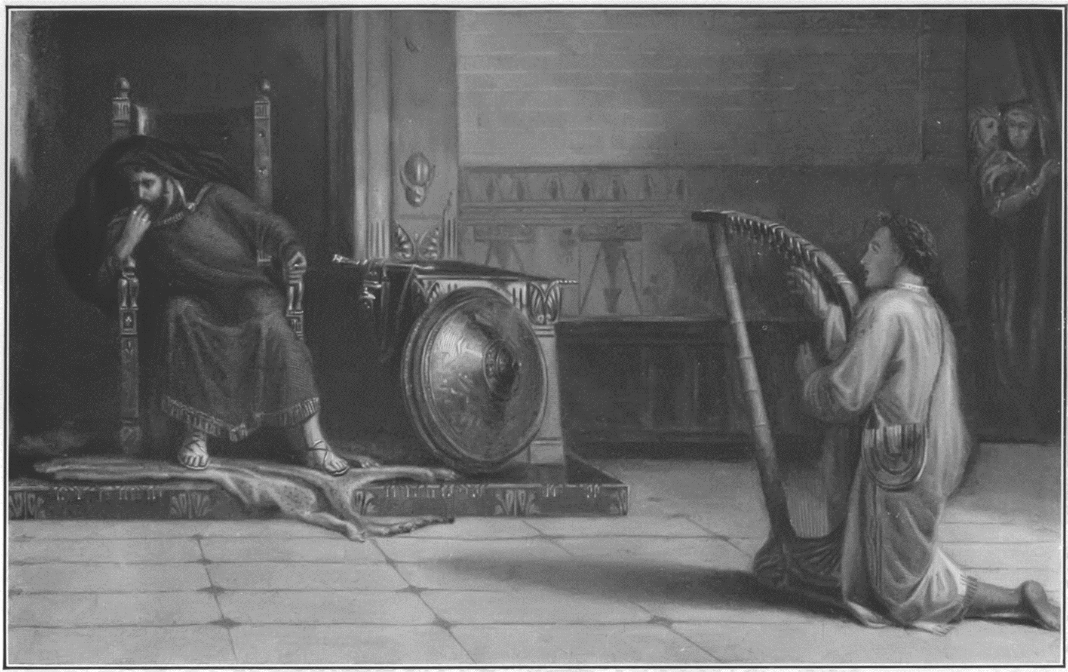
PERSECUTION
“ESCAPE!”
1 Samuel 19:18-24

Slide 2
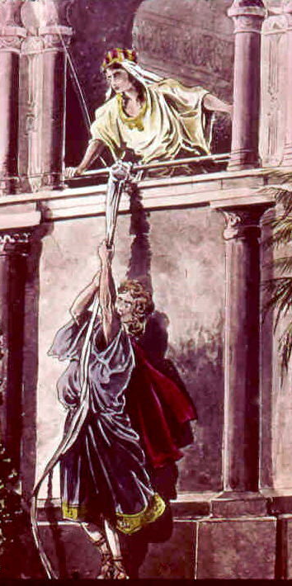
David’s Absconsion.
You need fellowship with believers in time of suffering.
They encourage and build you up!
We need the fellowship and accountability.

Slide 3
Ecclesiastes 4:9-12 Two are better than one; because they have a good reward for their labour. 10 For if they fall, the one will lift up his fellow: but woe to him that is alone when he falleth; for he hath not another to help him up. 11 Again, if two lie together, then they have heat: but how can one be warm alone? 12 And if one prevail against him, two shall withstand him; and a threefold cord is not quickly broken.

Slide 4
James 5:16 Confess your faults one to another, and pray one for another, that ye may be healed. The effectual fervent prayer of a righteous man availeth much.

Slide 5
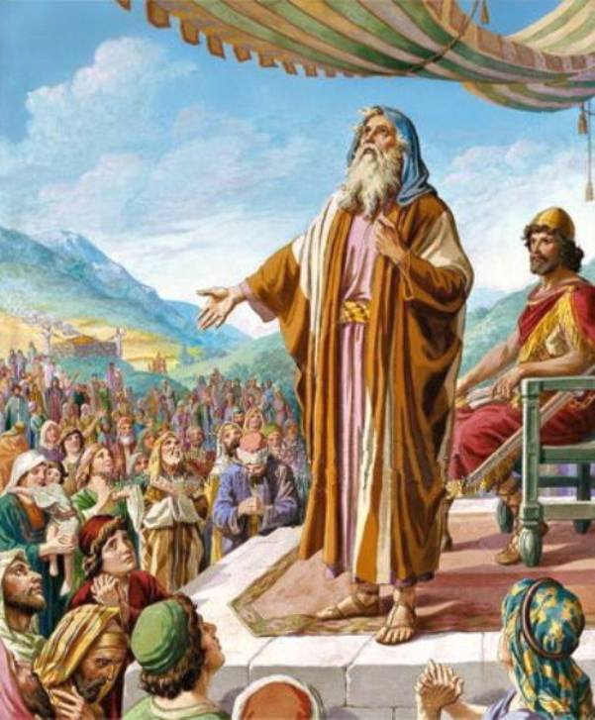
David’s Absconsion.
You need fellowship with believers in time of suffering.
They encourage and build you up!
We need the fellowship and accountability.
We need the prayers of the saints!
Running away in a time of trouble is good, as long as you run to God and his people!

Slide 6
Proverbs 18:10 The name of the LORD is a strong tower: the righteous runneth into it, and is safe.
Proverbs 17:19 He loveth transgression that loveth strife: and he that exalteth his gate seeketh destruction.

Slide 7
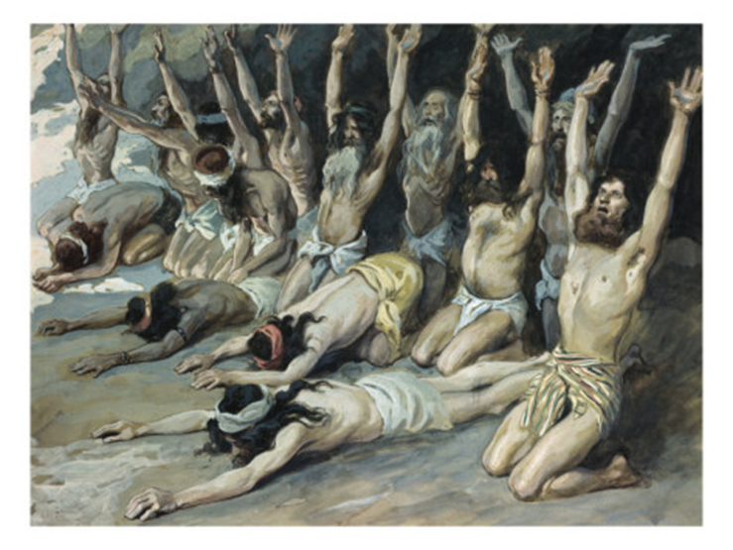
Assassin’s confusion.
Another murder attempt turned into much prophesying.
Note the picture! While a type of antichrist is on the rise and on the loose, a revival was taking place in the people of faith!

Slide 8
Revelation 7:13-15 And one of the elders answered, saying unto me, What are these which are arrayed in white robes? and whence came they? 14 And I said unto him, Sir, thou knowest. And he said to me, These are they which came out of great tribulation, and have washed their robes, and made them white in the blood of the Lamb. 15 Therefore are they before the throne of God, and serve him day and night in his temple: and he that sitteth on the throne shall dwell among them.

Slide 9


Slide 10

Assassin’s confusion.
Another murder attempt turned into much prophesying.
Note the picture! While a type of antichrist is on the rise and on the loose, a revival was taking place in the people of faith!
The assassins got sidelined by the Spirit!

Slide 11
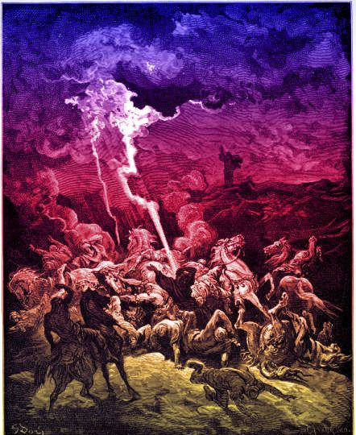

Slide 12
God can override the king’s authority!

Slide 13
Saul’s solution.
“if you want something done right,
you have to do it yourself!”
Saul comes full circle in his attempts to kill David.

Slide 14

God’s redirection.

Slide 15
1 Samuel 10:10-12 And when they came thither to the hill, behold, a company of prophets met him; and the Spirit of God came upon him, and he prophesied among them. 11 And it came to pass, when all that knew him beforetime saw that, behold, he prophesied among the prophets, then the people said one to another, What is this that is come unto the son of Kish? Is Saul also among the prophets? 12 And one of the same place answered and said, But who is their father? Therefore it became a proverb, Is Saul also among the prophets?

Slide 16
1 Samuel 18:6-8 And it came to pass as they came, when David was returned from the slaughter of the Philistine, that the women came out of all cities of Israel, singing and dancing, to meet king Saul, with tabrets, with joy, and with instruments of musick. 7 And the women answered one another as they played, and said, Saul hath slain his thousands, and David his ten thousands. 8 And Saul was very wroth, and the saying displeased him; and he said, They have ascribed unto David ten thousands, and to me they have ascribed but thousands: and what can he have more but the kingdom?

Slide 17

God’s redirection.
Why naked? God is shaming Saul!

Slide 18
Isaiah 47:3 Thy nakedness shall be uncovered, yea, thy shame shall be seen: I will take vengeance, and I will not meet thee as a man.
Exodus 32:25 And when Moses saw that the people were naked; (for Aaron had made them naked unto their shame among their enemies:)

Slide 19
Revelation 3:18 I counsel thee to buy of me gold tried in the fire, that thou mayest be rich; and white raiment, that thou mayest be clothed, and that the shame of thy nakedness do not appear; and anoint thine eyes with eyesalve, that thou mayest see.
Revelation 16:15 Behold, I come as a thief. Blessed is he that watcheth, and keepeth his garments, lest he walk naked, and they see his shame.

Slide 20
God’s redirection.
Why naked? God is shaming Saul!
We see God’s rejection of
Saul’s rebellion made plain.

Slide 21
2 Timothy 2:19-21 Nevertheless the foundation of God standeth sure, having this seal, The Lord knoweth them that are his. And, Let every one that nameth the name of Christ depart from iniquity. 20 But in a great house there are not only vessels of gold and of silver, but also of wood and of earth; and some to honour, and some to dishonour. 21 If a man therefore purge himself from these, he shall be a vessel unto honour, sanctified, and meet for the master's use, and prepared unto every good work.

Slide 22
God’s redirection.
Why naked? God is shaming Saul!
We see God’s rejection of
Saul’s rebellion was made plain.
Picture? Rebellion against God and
against His people results in your
shame!

Slide 23
2 Peter 2:9 The Lord knoweth how to deliver the godly out of temptations, and to reserve the unjust unto the day of judgment to be punished:
Proverbs 29:1 He, that being often reproved hardeneth his neck, shall suddenly be destroyed, and that without remedy.
Romans 2:5 But after thy hardness and impenitent heart treasurest up unto thyself wrath against the day of wrath and revelation of the righteous judgment of God;

Slide 24
God’s redirection.
Why naked? God is shaming Saul!
We see God’s rejection of
Saul’s rebellion was made plain.
Picture? Rebellion against God and
against His people results in your
shame!
Principle: religious experiences do
not change your character.
To change who a person is?
That takes submission to God’s Word.

Slide 25
2 Peter 1:4 Whereby are given unto us exceeding great and precious promises: that by these ye might be partakers of the divine nature, having escaped the corruption that is in the world through lust.

Slide 26
Saul rebelled against the Word of the Lord, so he was rejected by God.
1 Samuel 15:23 For rebellion is as the sin of witchcraft, and stubbornness is as iniquity and idolatry. Because thou hast rejected the word of the LORD, he hath also rejected thee from being king.

Slide 27
God protects His people!
Proverbs 3:5-6 Trust in the LORD with all thine heart; and lean not unto thine own understanding. 6 In all thy ways acknowledge him, and he shall direct thy paths.

Slide 28
PERSECUTION
“ESCAPE!”
1 Samuel 19:18-24

